Slide 1

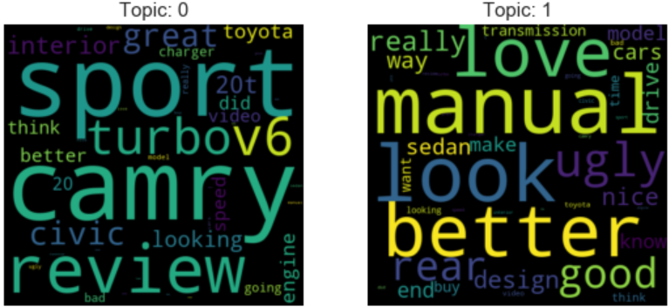
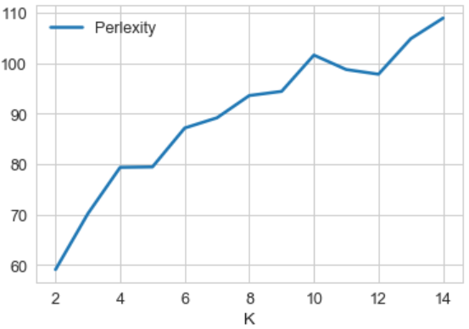
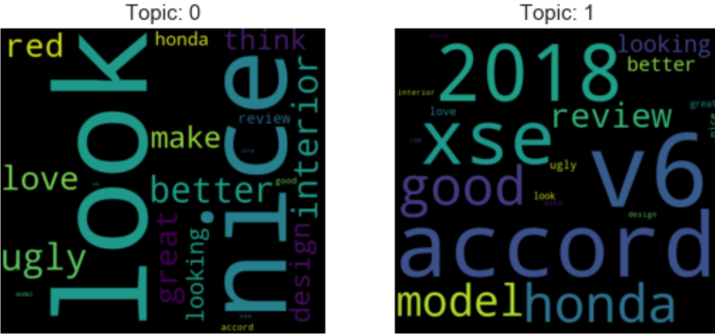
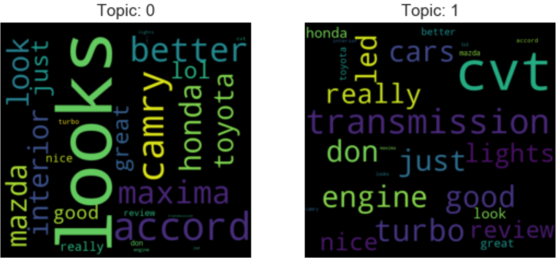
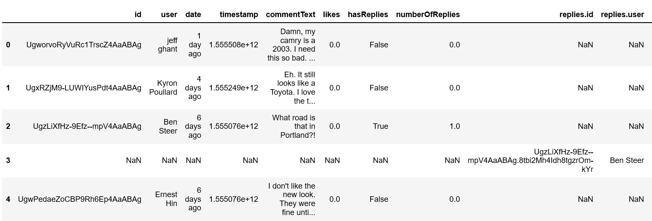
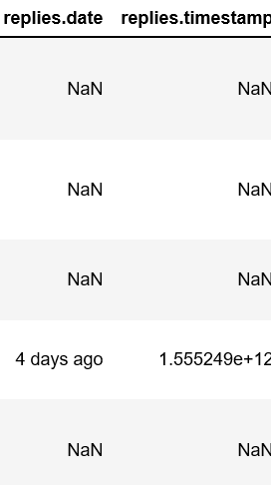
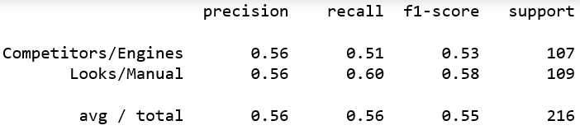
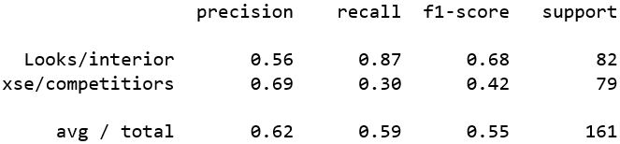
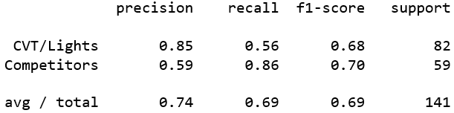
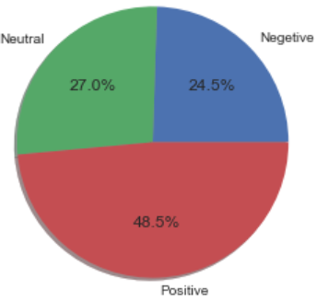
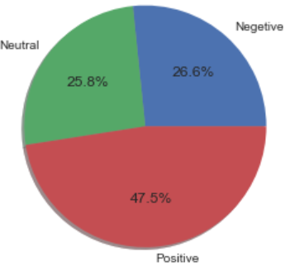
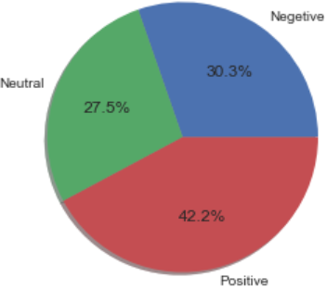
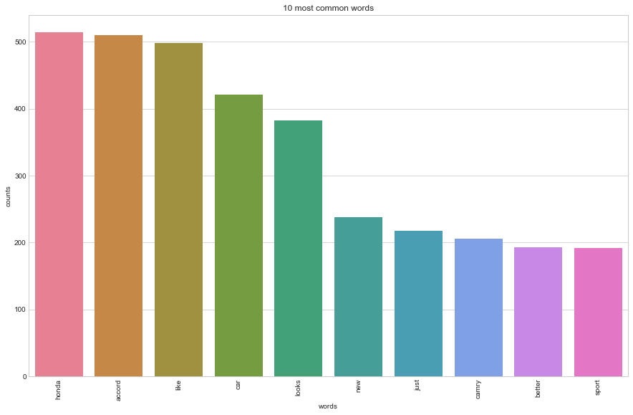
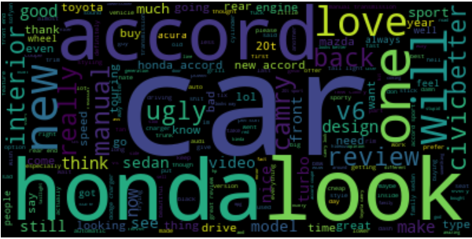
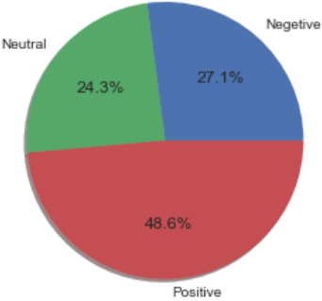
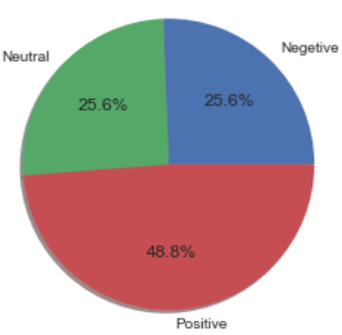
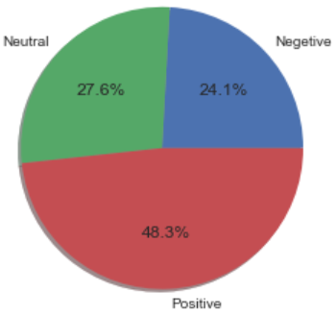
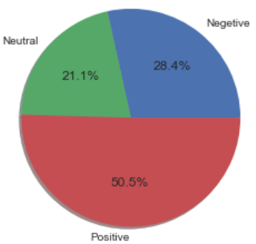
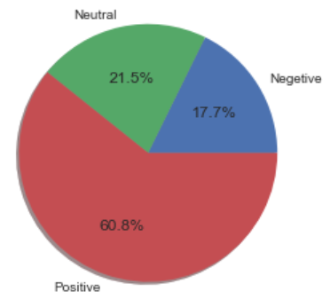
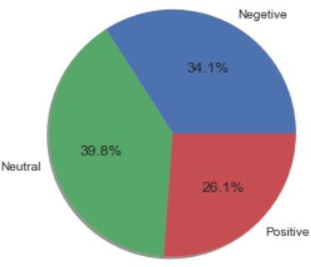
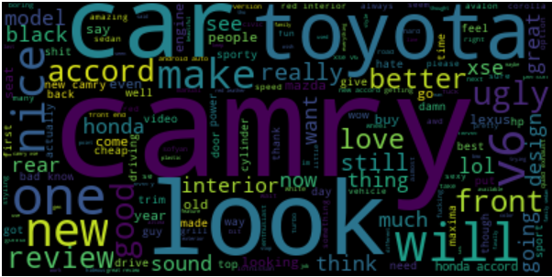
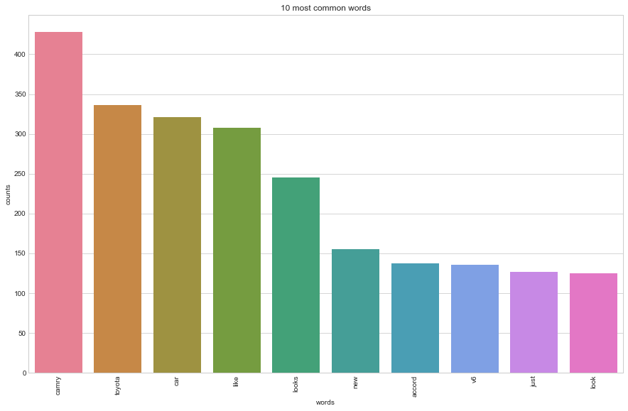
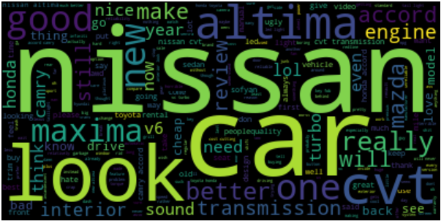
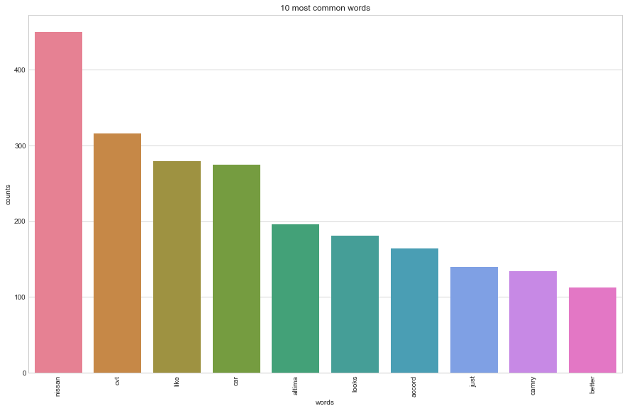
Product Analysis using YouTube comments Gaurav Sawant Advisor: Amir H. Gandomi
Statistical Learning & Analytics
Spring, 2019
Introduction: Problem
Reviews are one of the most watched YouTube videos
Is it possible for companies to get insights about customer sentiment towards products by using YouTube comments?
Can mining textual reviews provide any useful insights?
Business Value:
Get direct access to customer views on an open platform
YouTube comments longer than tweets, may pack more useful information
Methodology & Results
Latent Dirichlet Allocation (LDA) performed on all the comments to assign topics after removing stopwords
Test sets labeled using the decided topics
LDA performed again with test set to check performance
Honda Accord Topic 0: Competitors/Engine, Topic 1: Looks/Manual
Toyota Camry Topics Nissan Altima Topics
Perplexity is the measure used to decide k for topic modelling
LDA training test Results:
Honda Accord Toyota Camry Nissan Altima
Sentiment Analysis using VADER
Accord Overall Camry Overall Altima Overall
Accord by topic Camry by topic Altima by topic
Data & Data Processing
Comments of 3 competitor cars from popular YouTube channel Redline Reviews extracted using YouTube’s Data API
Rows with only original comments kept. Replies deleted
Columns with only text i.e. comments kept, others removed
Honda Accord- Published on 10/1/2017, 2155 comments
Toyota Camry – Published on 6/21/2017, 1603 comments
Nissan Altima – Published on 10/12/2018, 1444 comments
Other details: All 3 cars are in the same class, are all new models & are reviewed by the same reviewer
Removed punctuation marks, converted all text to lower case and removed stopwords when necessary
Some EDA
Honda Accord (No stopwords)
Toyota Camry (No stopwords)
Nissan Altima (No Stopwords)
Conclusion
Mining textual reviews can provide customer insights
Feedback about specific features can be obtained. Example: CVT transmission in Altima
Stopwords, min_df, max_df help produce better separation of topics while using LDA
Better separation & a greater number of topics are desired & could help produce better results
Labelling the test data is a time-consuming job and requires some domain knowledge

